Slide 1

MODCOM INSTITUTE OF TECHNOLOGY Student PROJECT

Slide 2
NAME:Lungaho Ramsey
Project Name :Allware

Slide 3
Problem definition/Need
A lot of computer users need to start somewhere in order to purchase the type of products they need there has been a lot of online stores etc jumia amazon that offer various hardware and software but none has been able to cater the specific needs of the user in terms of purpose.
You want a pc or laptop for use in programming?
You need a laptop for your secretarial work?
You want a specific drive ie hdd or sdd but don’t know which is suitible for your work?

Slide 4
Solution
Allware is an e-commerce application that helps both buyers and sellers to buy and sell hardware and software and computer parts for specific needs
The never seen before application sends and receiv

Slide 5
The current app is in its beta version the get api for the hardware and software inputs are not completely functional.
The login and session are not functional but are to be implimented for the admin and buyer taking admin to dashboard.

Slide 6
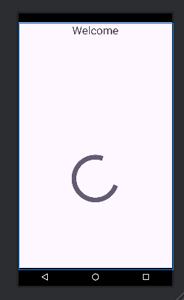
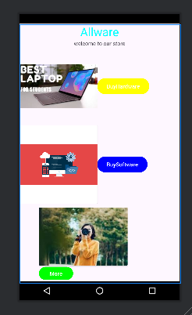
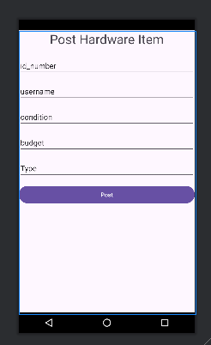
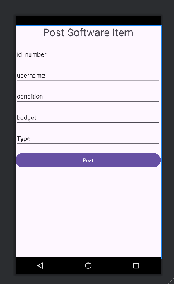

Slide 7
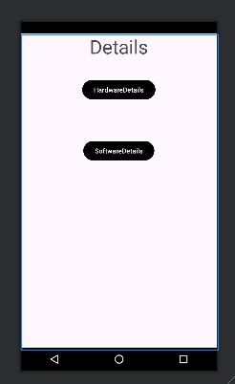
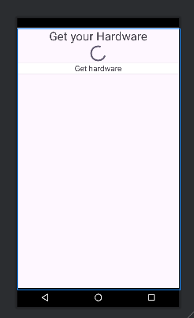
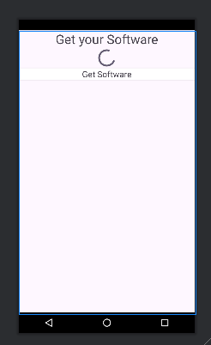

Slide 8
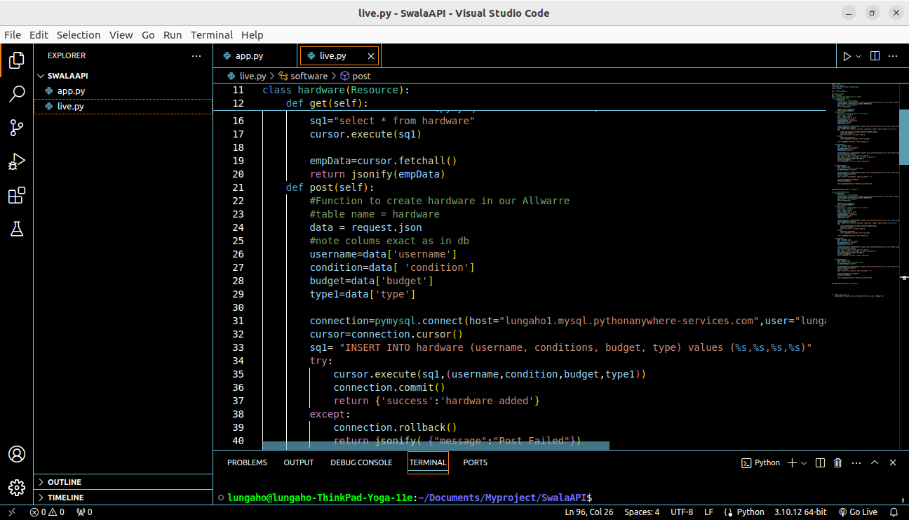

Slide 9
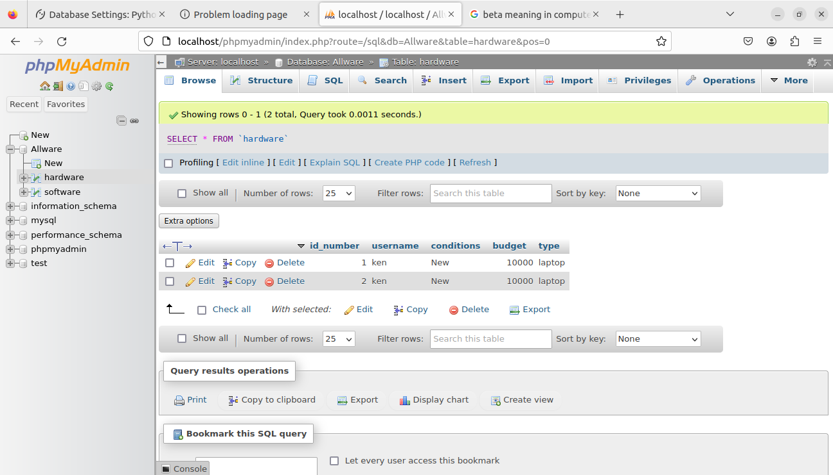

Slide 10
Target Audience
This system will be used by both hardware and software buyers and sellers
i.e programmers,technicians,computer students,computer institutes,tech companies,secretaries etc.
Revenue models i.e
Downloads.
Ads.
Selling Products and software affiliation.
Commissions

Slide 11
Conclusion
This project can save its users time and money and in future versions can be upgrade for large scale use.

Slide 12
Thank You

